Slide 1
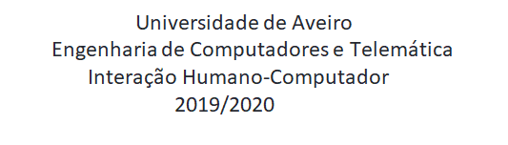

CookIT Requirements analysis
Bruno Caseiro 88804 Mateusz Roganowicz 96947
Ruben Menino 89185
Teacher: Beatriz Sousa Santos
Class: P1

Slide 2
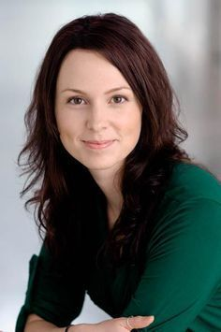
Personas
Joana, 40 years old
Medical School graduate
Wants to learn how to cook
Looks for an application which could facilitate cooking
Wants to have all receipts in one place
Wants to get suggestions what to cook

Slide 3
Tasks
Tell you what ingredients are needed for given recipe
Be able to manage recipe categories (vegetarian, fast-food, etc…)
Add the ingredients that user has to cook

Slide 4
Scenario 1
Joana wants to spend free time at the weekend and looks for the recipes to bake an apple pie. In the application she inputs the name of the cake and gets the recipe.

Slide 5
Scenario 2
Joana wants to try a vegan dish for the first time, but isn’t sure which one. She filters the list of recipes available by category (vegan) and picks the one which seems the most appealing to her.

Slide 6
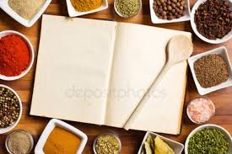
Requirements
Non-functional requirements
Usability
Implementation
Reliability

